Slide 1

Opening Session
Eduardo López Gonzalo
eduardo.lopez@upm.es
Luis Hernández Gómez
luisalfonso.hernandez@upm.es

Slide 2
Opening Session
Program Overview
Internships and Master Thesis
Students’ presentations
Predictive & Descriptive Learning and Machine Learning Lab tools
Level Test

Slide 3
Opening Session
Program Overview
Internships and Master Thesis
Students’ presentations
Predictive & Descriptive Learning and Machine Learning Lab tools
Level Test

Slide 4
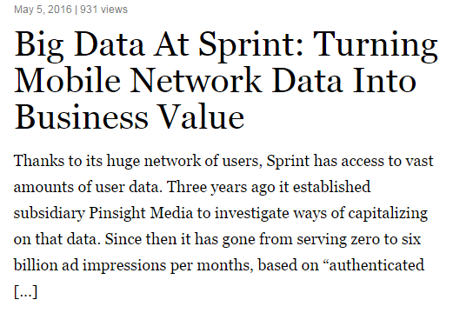
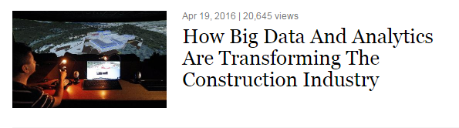
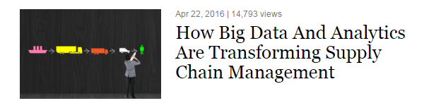
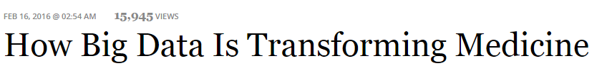
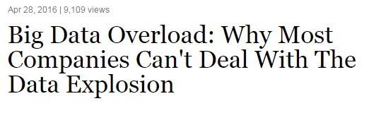
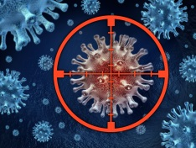
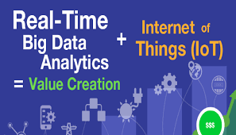
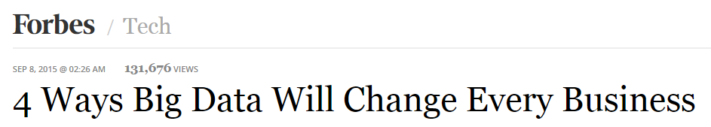
The Data Revolution: Big Data

Slide 5
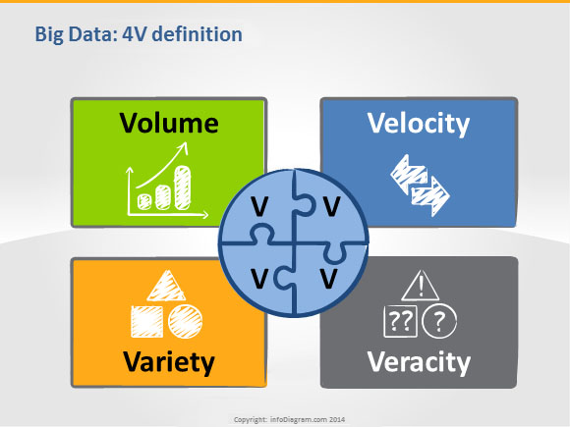

Slide 6
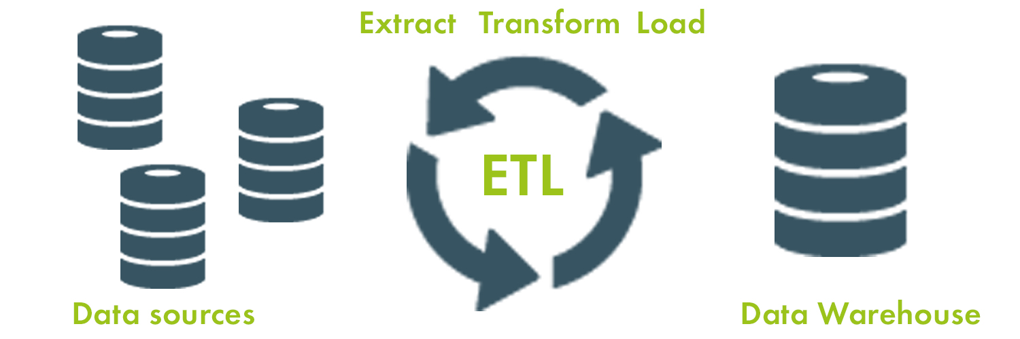


1970s ETL (Extract, Transformation, Loading)
Data is extracted: from the existing sources
Data is then transformed: for its specific use
Data is loaded: into the final target operational database or data warehouse.
Source:

Slide 7
D. Laney. "3D Data Management: Controlling Data Volume, Velocity and Variety" Gartner. 2001

Slide 8
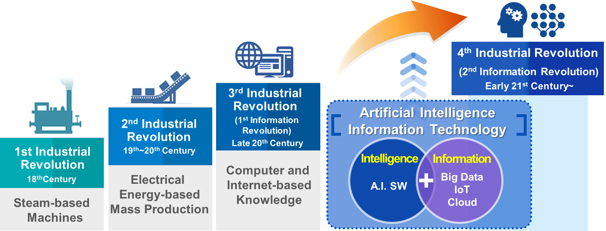

Slide 9
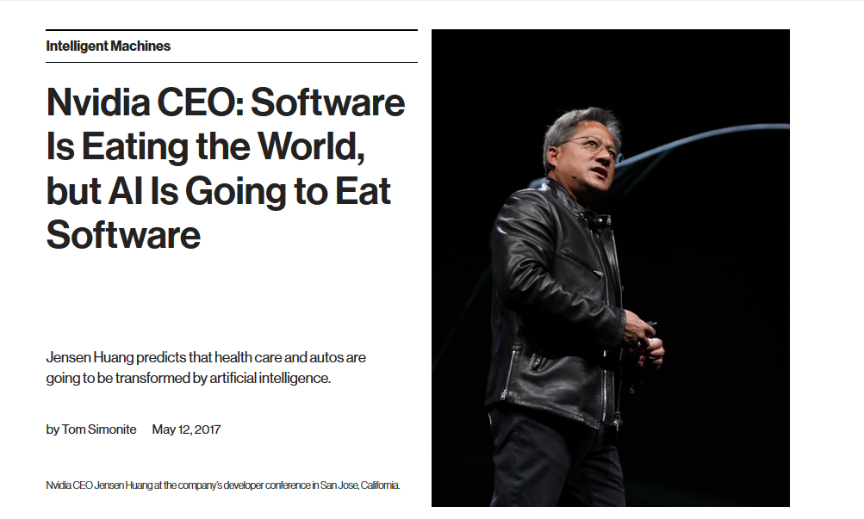

Slide 11
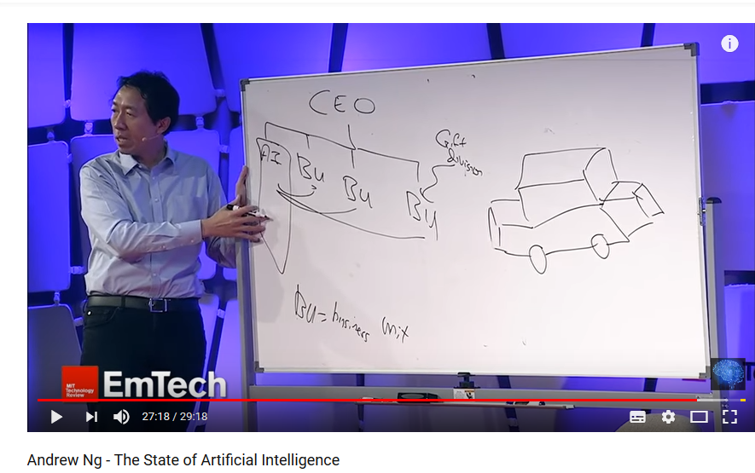

Slide 12
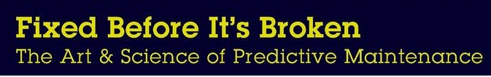
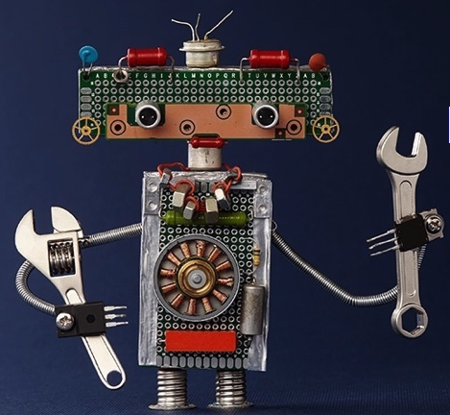
MANY DIFFERENT FIELDS & APPLICATION DOMAINS
Music Recommendation
systems
Is this song similar to that one?
When can this song become a hit?
Should I recommend this song?
Predictive Maintenance of machinery
Is that behavior normal?
When the machine is going to fail?
Should I add this machine to the review list?

Slide 13
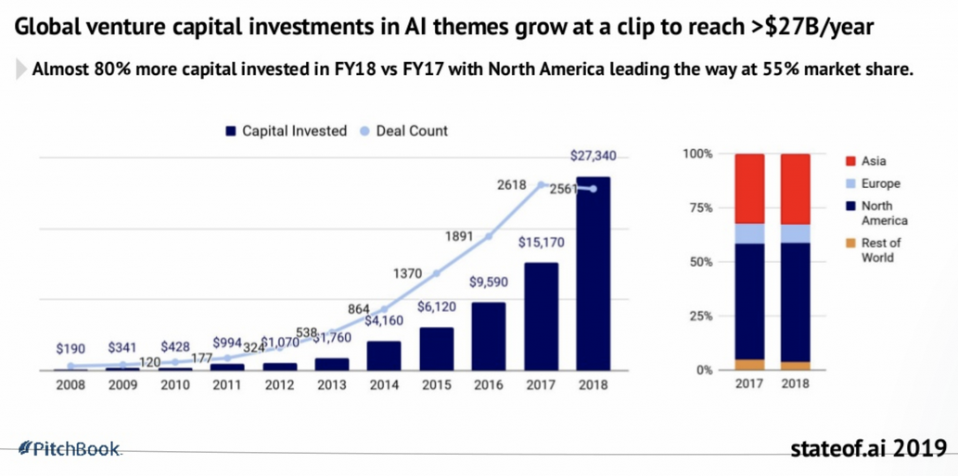

Slide 14
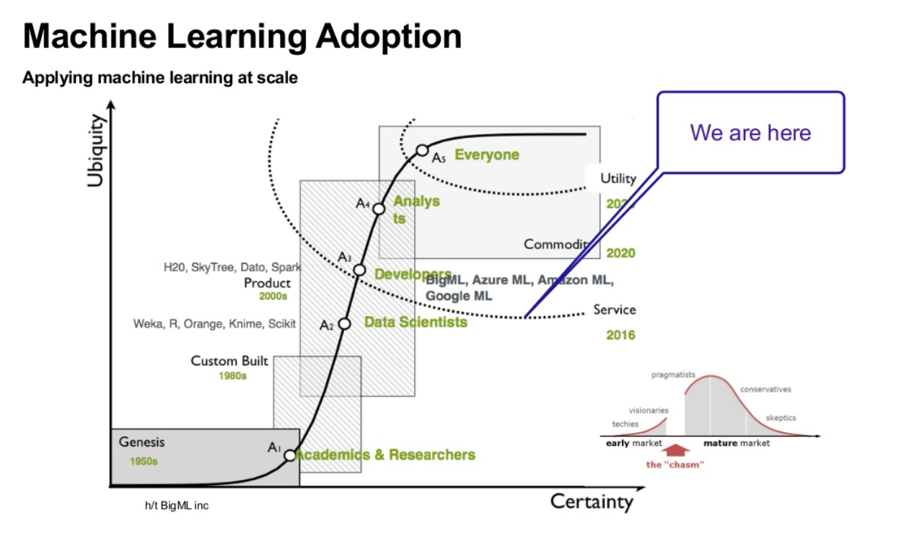

Slide 15
The Key:
Look for productivity!

Slide 16


Slide 17
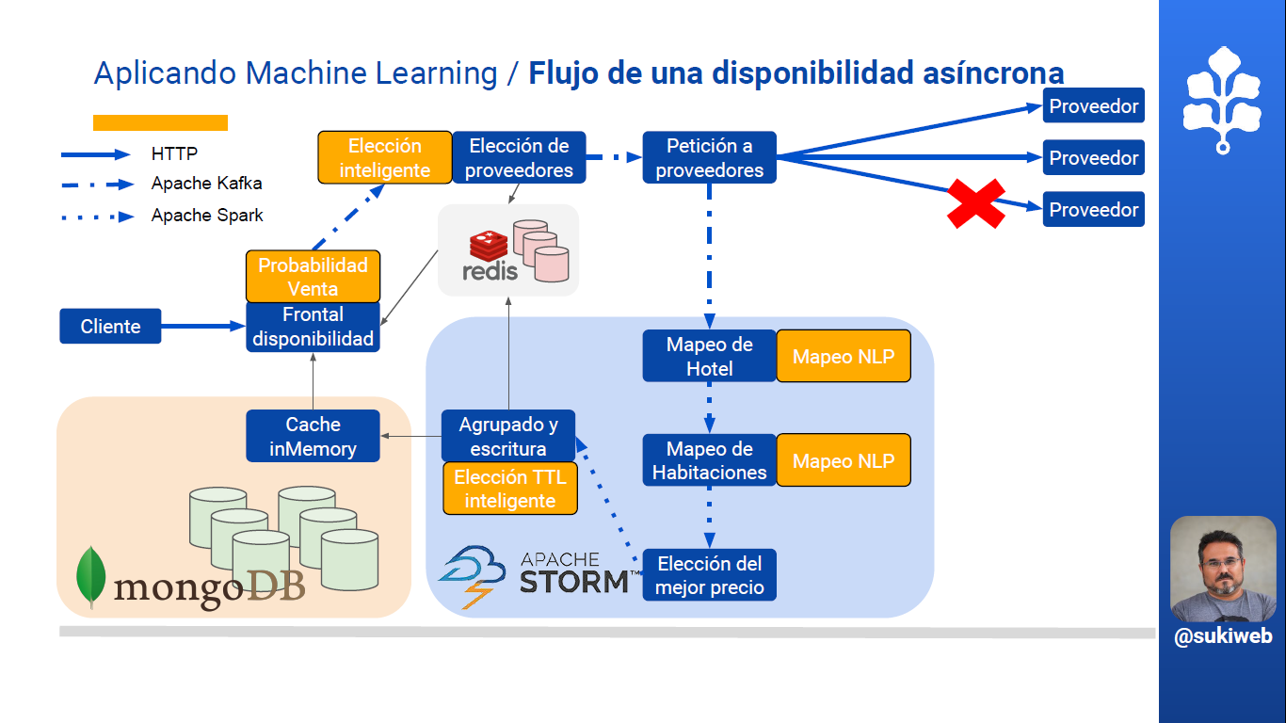

Slide 18
Where are we?
Data Science
Machine Learning

Slide 19
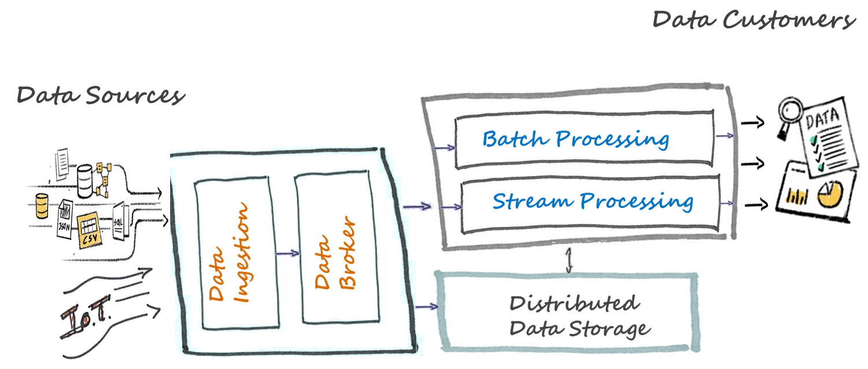
Big Data Architecture

Slide 20


Big Data Architecture

Slide 21
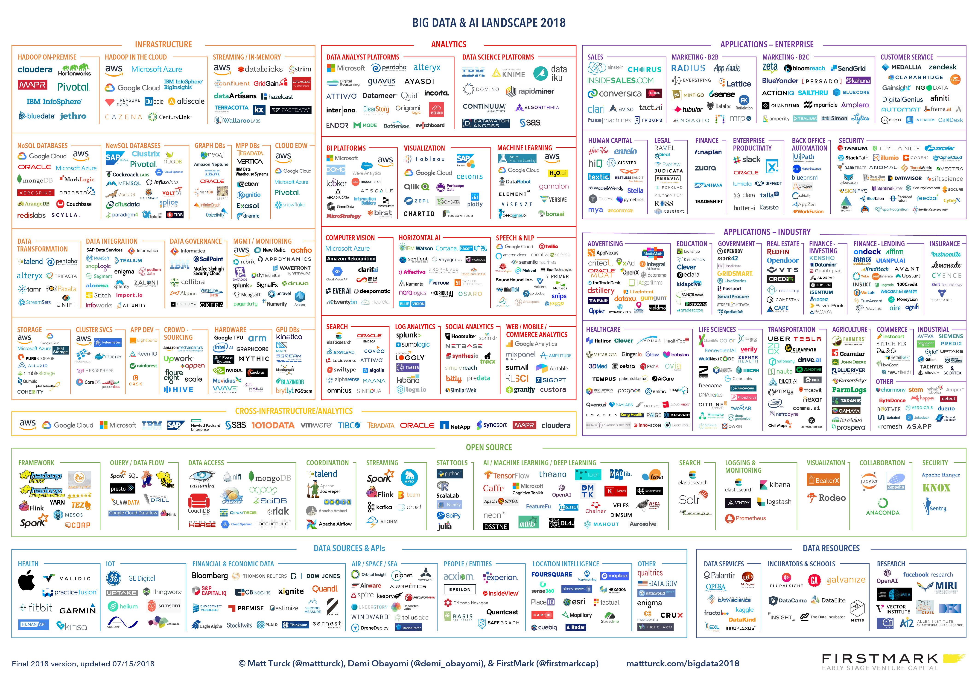

Slide 22

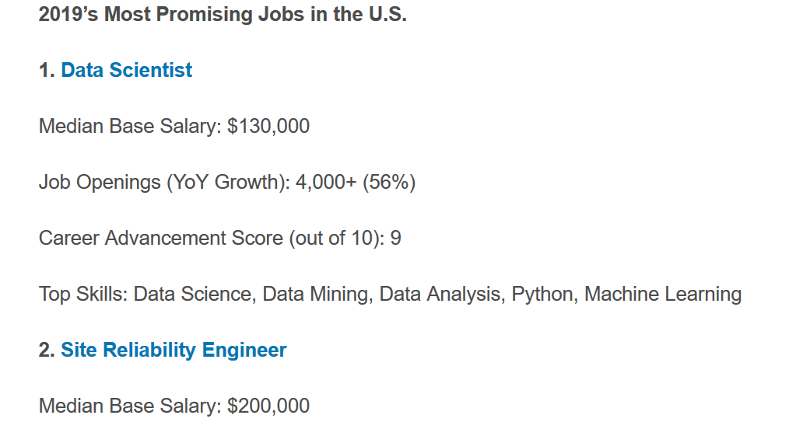

Slide 24
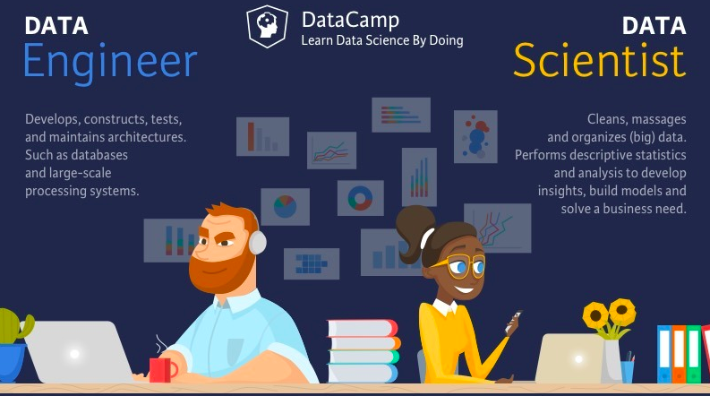

Slide 25
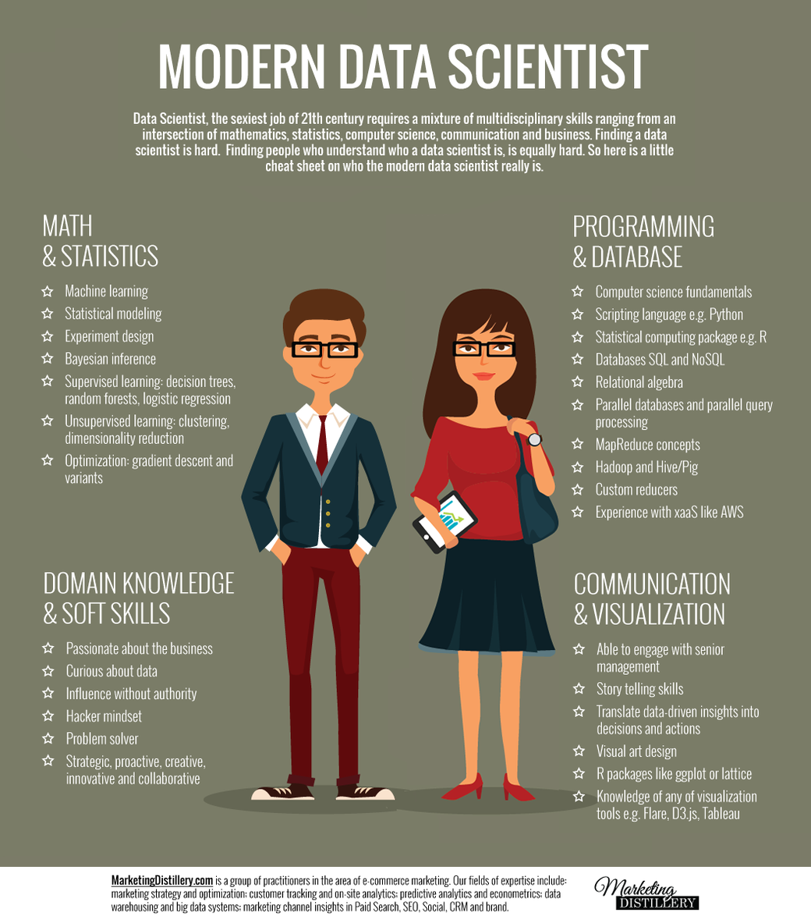

Slide 26
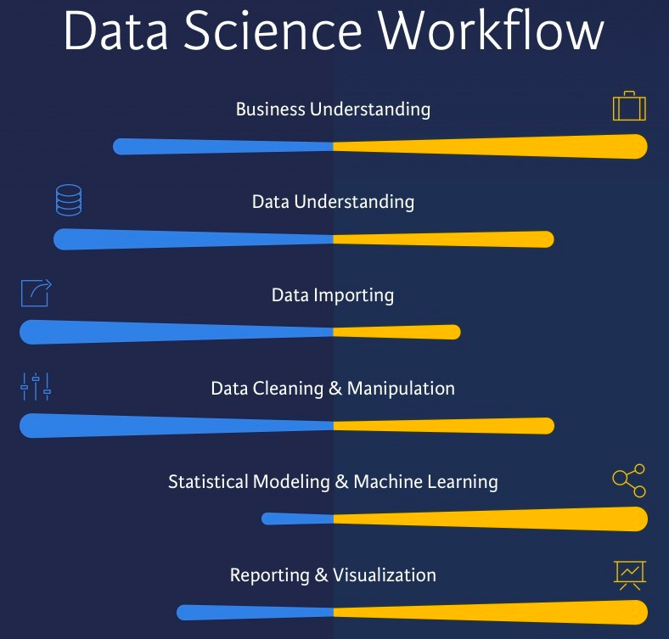

Slide 27
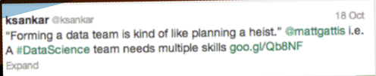
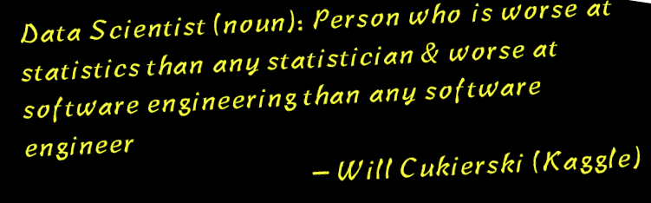
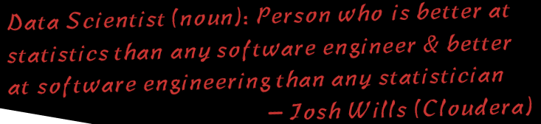
What is Data Science?
The curious case of the Data Scientist

Slide 28

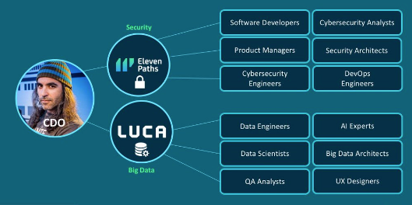
Chief Data Officer

Slide 29

… but there are some “buts”!!!

Slide 30

… there are “some” important issues to consider!
and not “only” those related to data privacy, security..….

Slide 31


Slide 32

So focus your future big professional potential in improving our world!!!

Slide 33
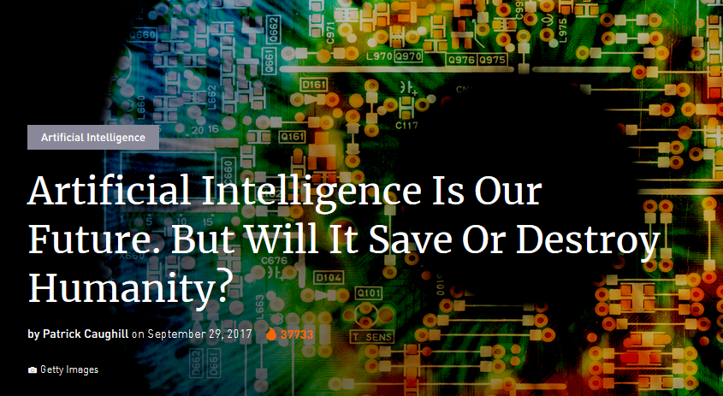

Slide 34
Kumaran AkilanSoftware Engineer at Archie.ai
Sep 2, 2017
Artificially Intelligent Engineers — How AI Will Kill All Engineering Jobs.
-And Why It Is a Good Thing.

Slide 35
… we will discuss about Ethical issues in the second semester:
Application Projects Course

Slide 36
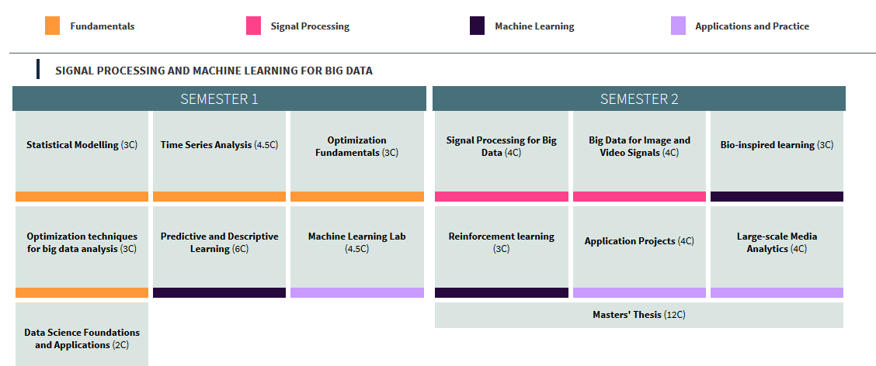
Our Courses
http://mstc.ssr.upm.es/
Review Schedule!!!

Slide 37
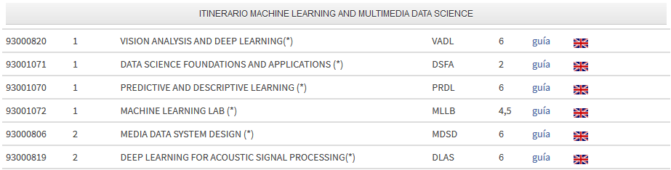
Our Courses: MUIT
http://www.etsit.upm.es/da/estudios/master-universitario-en-ingenieria-de-telecomunicacion/plan-de-estudios/asignaturas.html

Slide 38
Opening Session
Program Overview
Internships and Master Thesis
Students’ presentations
Predictive & Descriptive Learning and Machine Learning Lab tools
Level Test

Slide 39
Opening Session
Internships and Master Thesis
We recommend you:
To be involved in internships with companies or research groups
To start working on your Master Thesis
… as soon as possible!

Slide 40
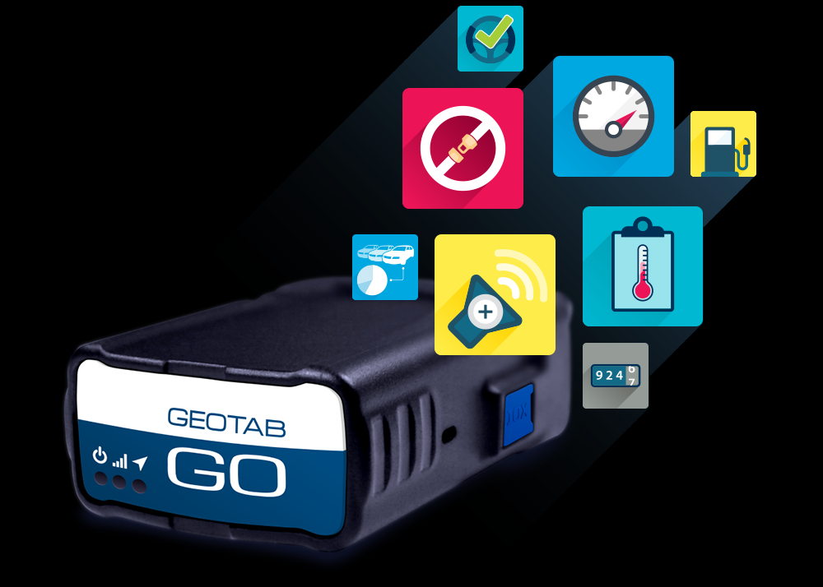

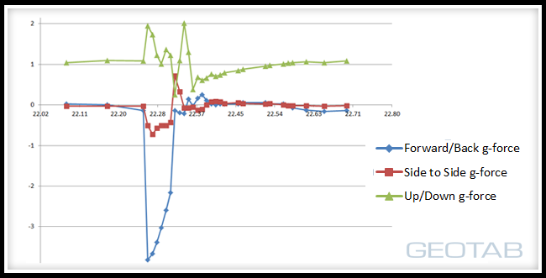
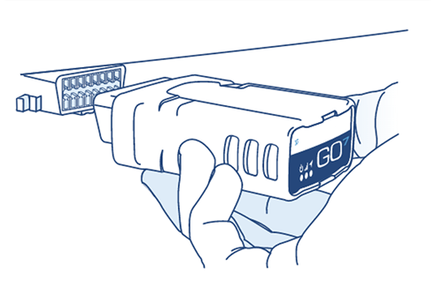
Road Accident Prediction and Characterization using
Convolutional Neural Networks

Slide 41
Opening Session
Program Overview
Internships and Master Thesis
Students’ presentations
Predictive & Descriptive Learning and Machine Learning Lab tools
Level Test

Slide 42
Opening Session
…. your turn!
(prepare it for tomorrow)

Slide 43
Opening Session
Program Overview
Internships and Master Thesis
Students’ presentations
Predictive & Descriptive Learning and Machine Learning Lab tools
Level Test

Slide 44
Opening Session
…. also closely related to:
Data Science Foundations and Applications

Slide 45
Learn the
Global Picture!!!
…from the beginning

Slide 46
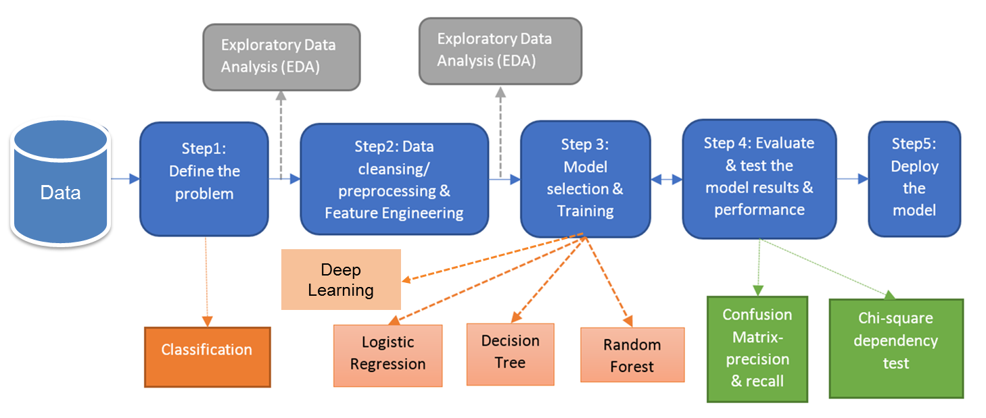
Global Picture Example

Slide 47
Opening Session
Don’t forget to bring you laptops to class
Data Science Foundations and Applications
Predictive & Descriptive Learning
Machine Learning Lab

Slide 48







Slide 49

Opening Session

Slide 50

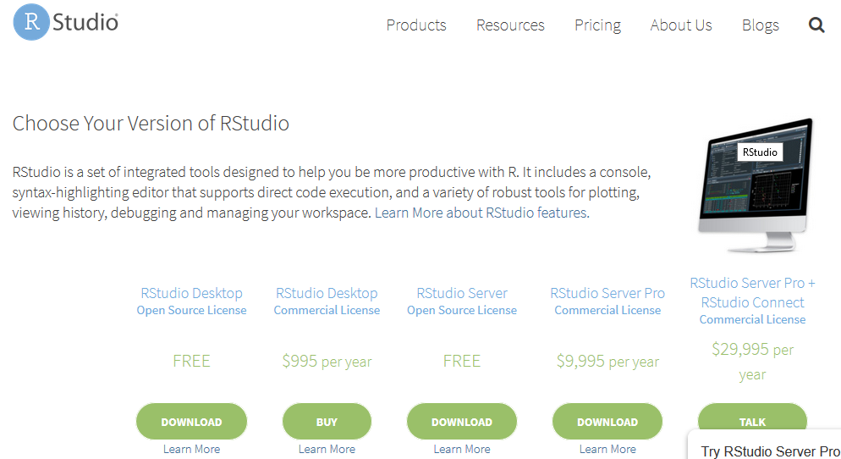
Opening Session
Install R and then R Studio

Slide 51


Opening Session
For Python we recommend ANACONDA distribution
https://www.anaconda.com/download/

Slide 52
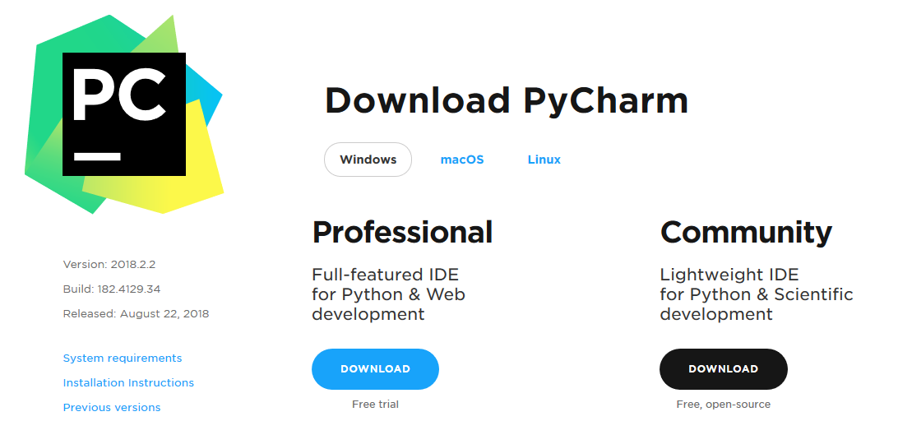
Opening Session

Slide 53
Opening Session
Don’t forget to bring you laptops to class
Data Science Foundations and Applications
Predictive & Descriptive Learning
Machine Learning Lab

Slide 54
Opening Session
Program Overview
Internships and Master Thesis
Students’ presentations
Predictive & Descriptive Learning and Machine Learning Lab tools
Level Test

Slide 55
Opening Session
Level Test
Don't be afraid, it is just to know each other better!
(…on the academic side)

Slide 56
MSTC Overview
Eduardo López Gonzalo
eduardo.lopez@upm.es
Luis Hernández Gómez
luisalfonso.hernandez@upm.es

